Slide 1
Identifying a reliable blubber measurement site to assess body condition in a marine mammal with topographically variable blubber, the Pacific walrus, Where is the optimal place to measure blubber?
By: Celebrity Wright, Hayden Loan, Aly Colasanti, David Hoffmann, & Caleb Landry

Slide 2
Response variable and predictors
Response variable: body condition
Predictors: blubber thickness

Slide 3
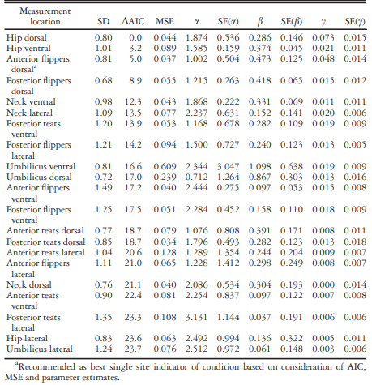
Aic table

Slide 4
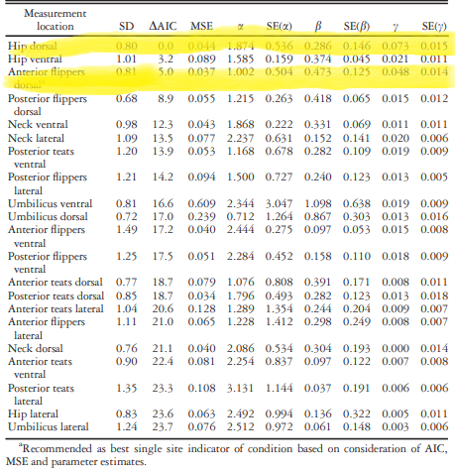
Important models

Slide 5
Concluding remarks
To reiterate, the best model for determining body condition or blubber thickness of walrus was body mass of the hip dorsal and anterior flippers dorsal.

